Slide 1

Introduction to SPARK

Slide 2
Agenda
What is SPARK
Spark architecture
Job execution in SPARK
Spark deployment modes
Demo

Slide 3
What is SPARK ?
A parallel processing framework
Its open source
Developed at the university of California, Berkeley
Team that created SPARK went on to form a company DATABRICKS in 2013
Initial release was in May 30th 2014
Developed predominantly using Scala
High throughput applications deployed on spark enjoys the best performance if developed in SCALA

Slide 4
What is SCALA ?
A high level programming language
Supports functional style of programming
Supports OO style of programming
It’s actually a multi-paradigm language

Slide 5
What is functional programming ?
Consider the following code snippet
int a = 10; //A new variable “a” is getting created
a++ ; // We are incrementing the variable a
Print(a) // will generate 11 as the o/p
Consider another way of doing the same thing
int a= 10;
int a1 = a + 1 ; // We are creating a new variable a1
Print(a) ; // a will still contain the value 10, state of the //variable a is not changed.

Slide 6
Functional programming
Functional style of programming inherently supports parallelism
Functional style of programming is not restricted to a particular programming language
It can be implemented in any language, just like the way OO concepts can also be implemented in a programming language like C
Certain programming languages inherently support functional style of programming reducing the programmer’s burden
Scala is one of the functional programming languages

Slide 7
SPARK in comparison to HADOOP
The high level architecture of SPARK is very similar to that of HADOOP
A quick way of understanding SPARK is by comparing it with HADOOP
Several drawbacks of Hadoop are addressed in Spark which gives a 10x-100x performance improvement over Hadoop
Its well suited for interactive and real time analytics of big data and streaming data
Its highly popular among machine learning users since it outperforms Hadoop in iterative workloads

Slide 8
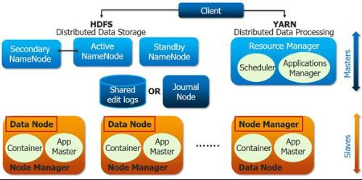
A QUICK RECAP OF HADOOP

Slide 9
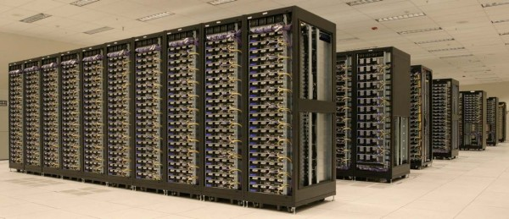



Overview of job execution in HADOOP
Name node
Resource manager/YARN
Data nodes
Job client
Name node
A job submitted by the user is picked up by the name node and the resource manager
Job gets submitted to the name node and eventually resource manager is responsible for scheduling the execution of the job on the data nodes in the cluster
The data nodes in cluster consists the data blocks on which the user’s program will be executed in parallel

Slide 10
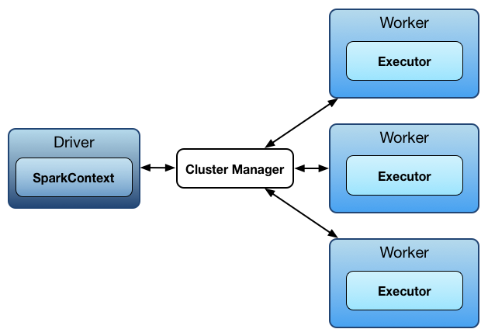
Overview of SPARK architecture
Driver is the starting point of a job submission (this can be compared to the driver code in Java MR)
Cluster Manager can be compared to the Resource Manager in Hadoop
Worker nodes are the data nodes in a HADOOP cluster
The executor can be compared to that of a node manager in Hadoop 2 or task tracker in Hadoop 1

Slide 11
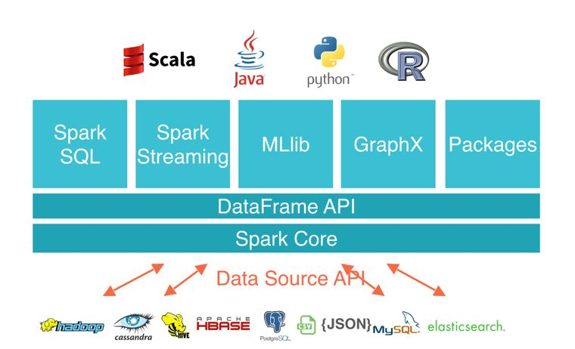
SPARK architecture

Slide 12
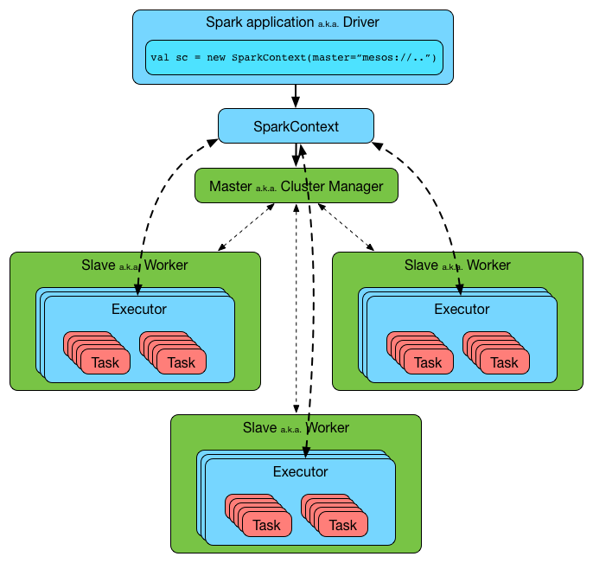
A closer look into the SPARK architecture

Slide 13
Spark deployment modes
Standalone (used for learning & development)
This is very similar to the pseudo distributed mode of Hadoop
Spark services run on multiple JVM’s
This is also known as standalone cluster
Local mode (used for learning & development)
There is a single JVM (no need of HDFS)
Cluster mode (can work with MESOS or YARN)
Used for production environment & it’s a fully distributed mode

Slide 14
Summary
What is spark
Functional programming
Overview of SPARK architecture in comparison to Hadoop
Deployment modes of SPARK

